Slide 1
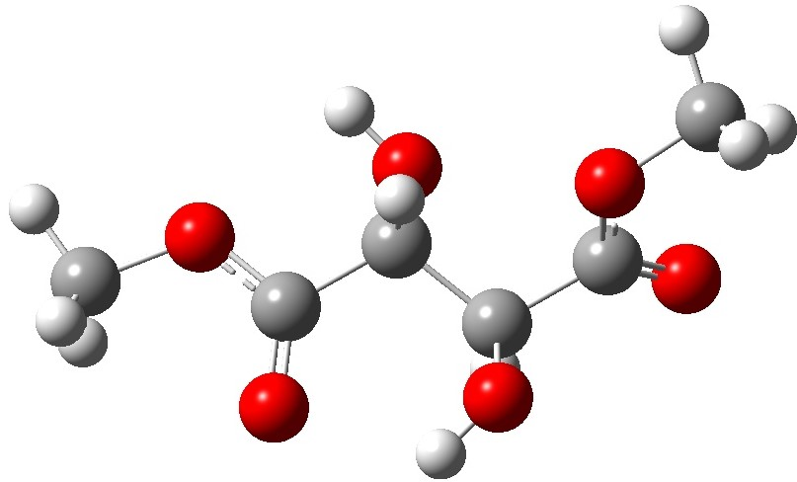
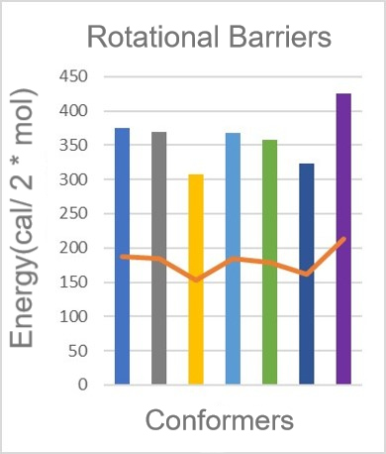
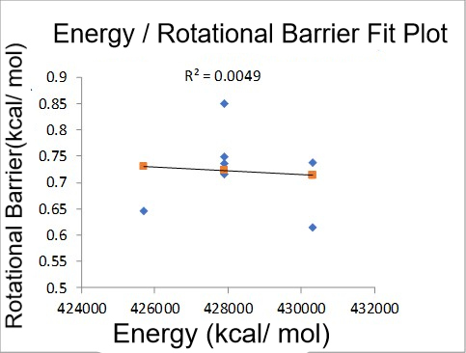
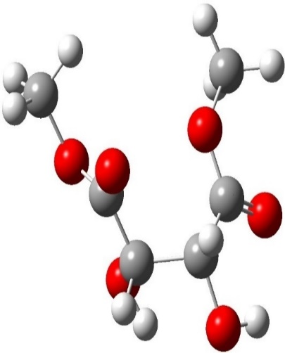
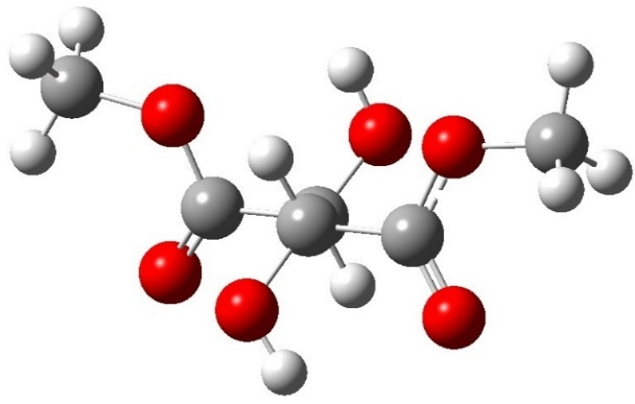
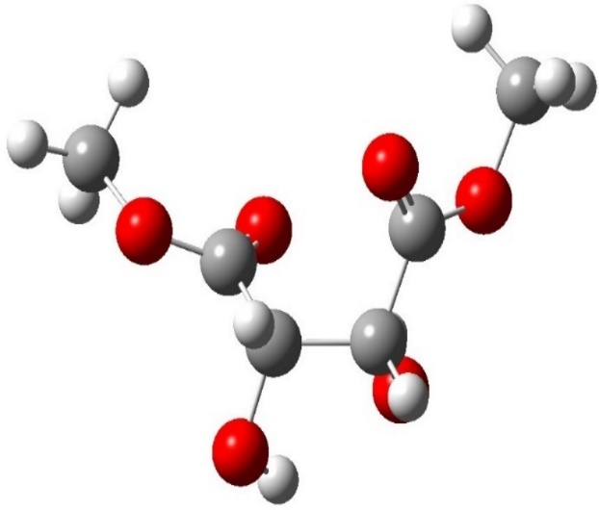
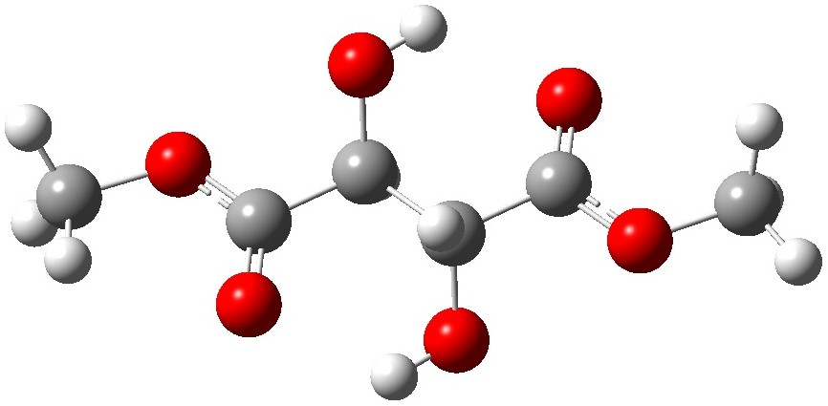
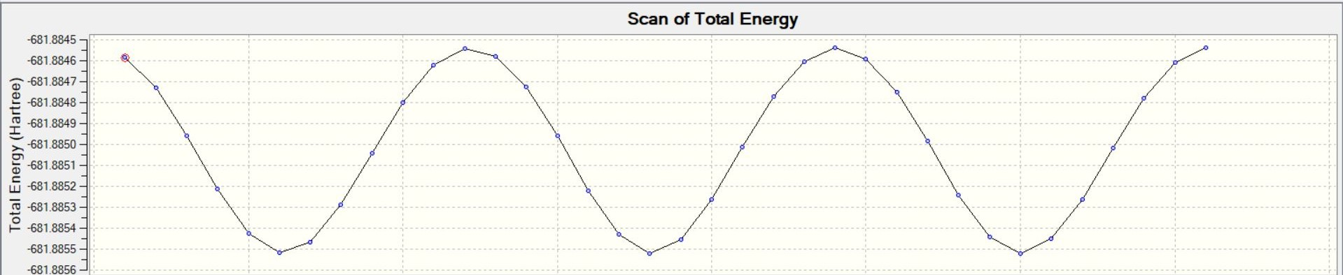
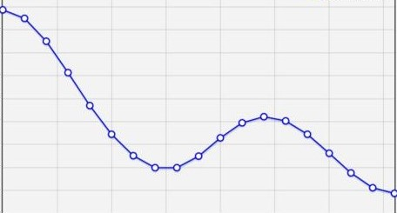
A Theoretical Study of The Methyl Rotational Barrier In Dimethyl Tartrate Energy Conformers
Hussein Faara and Daniel J. O’Leary
Pomona College, Claremont
Introduction
Results
The methyl rotational barrier of dimethyl tartrate plays a significant role in understanding the stereochemistry and the dynamics of esters. Over 45 different conformers of dimethyl tartrate are known to exist but little information is provided on how the energy of each conformer affects its methyl rotational barrier. A study of the relationship between a conformer’s energy and its methyl rotational barrier will give a better understanding of the steric effects between molecules and their substituents. Thus, it is important that computational techniques are used to model the possible conformers of dimethyl tartrate to examine the above said relationship
dimethyl tartrate
Fig.2. A plot showing the relative energies of all 45 dimethyl tartrate conformers. The energy differences between consecutive conformers were plotted on a scatter plot.
Objectives
Identify and optimize geometries of existing dimethyl tartrate conformers.
Compute the rotational barriers of the identified conformers
Investigate the existence of a relationship between a conformer’s energy and the rotational barrier.
Methods
Fig.3. The rotational barriers of the conformers and a line depicting how they vary.
Fig.4. A linear regression depicting the relationship between a conformer’s energy and it’s rotational barrier.
The Maestro software was used with the Merck Molecular Force Field (MMFF) to generate the 45 dimethyl tartrate conformers.
2. Gaussian 09 was used to perform geometry optimizations(Fig.1) of the conformers in order to obtain the lowest energy structure for each conformer. The rotational barriers were then determined by performing Potential Energy Surface(PES) scans on seven of the conformers with relative energy differences of about 2 kcal, a value that is indicative of structures likely to exist at room temperature.
Fig.1. A visualization of the iterations geometry optimizations utilize to achieve the lowest energy conformation of an energy structure.
Discussion and Future Work
An examination of the rotational barriers of the 7 isomers discovered no significant differences in the methyl rotational barriers of the different dimethyl tartrate conformers (Fig.3). The data suggested no significant relationship between the energy of a conformer and its rotational barrier, as shown by the correlation coefficient(Fig.4), which could mean that the barrier to rotation of a group is an inherent molecular property.
Further research is going to be centered on:
Experimentally determining the validity of the behavior predicted by computation.
Repeating the process for other groups of compounds to determine if the rotational barrier is an inherent property.
Acknowledgements
This summer undergraduate research project was funded by the Pomona College Chemistry Department.

